Slide 1
Modeling principles

Slide 2
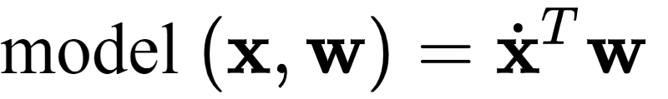
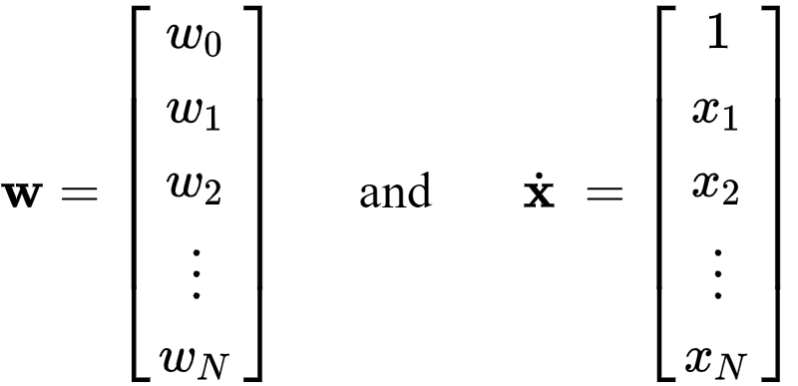
In Chapter 5 we detailed the basic linear model for regression as
or more compactly as , denoting

Slide 3
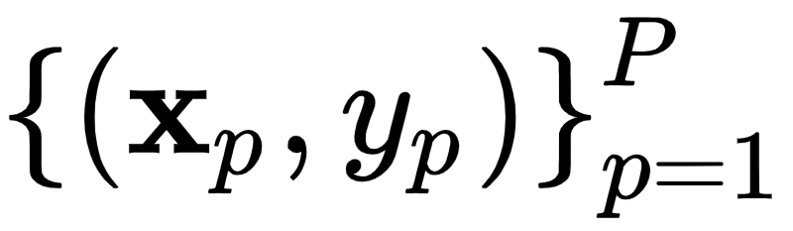

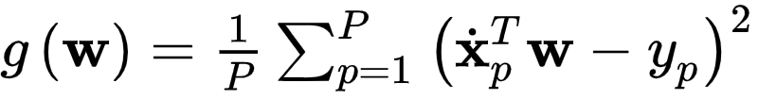
Using a generic dataset of P input-output pairs we then minimized a proper regression cost function, e.g., the Least Squares cost below in order to find optimal values for the parameters of our linear model (here, the vector ).

Slide 4


We can move from linear to general *nonlinear* regression by swapping out the linear model with a nonlinear one, for instance a single nonlinear function f that can be parameterized or unparameterized.
In the jargon of machine learning ‘f’ is often called a nonlinear *feature transformation*.
Here the set represents all tunable parameters - both those potentially internal parameters of the function ‘f’ and those weights in the linear combination.

Slide 5
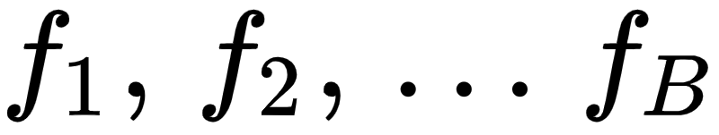

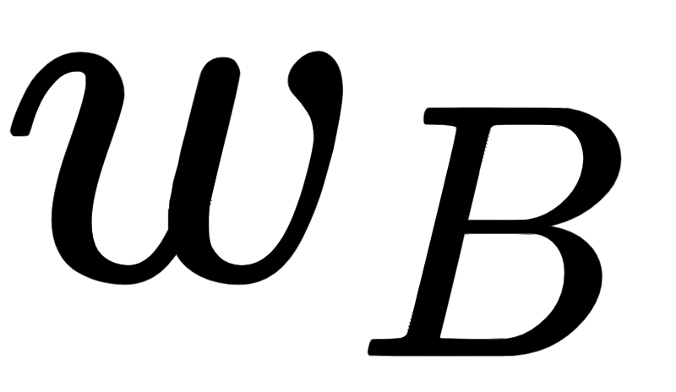
In general we could create a nonlinear model that is the weighted sum of B nonlinear functions of our input as
Here are nonlinear parameterized or unparameterized functions - or *feature transformations*.
Once again through (along with any additional weights internal to the nonlinear functions) are represented in the weight set and must be tuned properly.

Slide 6
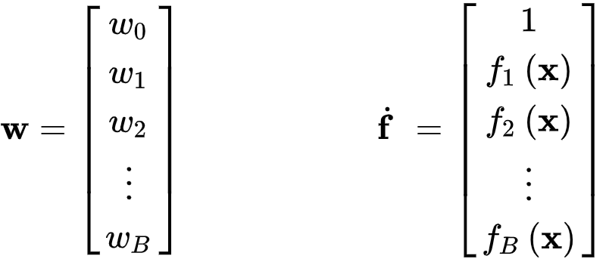
In analogy to the linear case, here we too can compactly denote the generic nonlinear model by taking a 1 on top of the vector of nonlinear feature transformation as

Slide 7
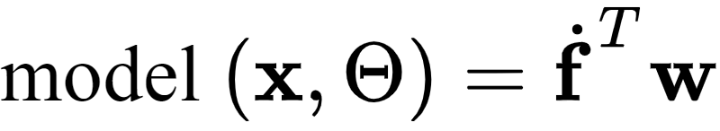
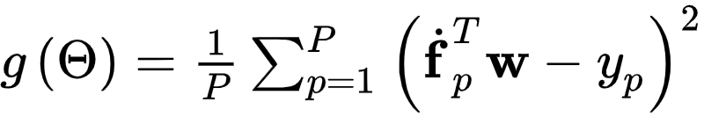
With this notation we can write our generic nonlinear model compactly as
To tune the parameters of our general nonlinear model we minimize a proper regression cost function over , e.g., the Least Squares cost

Slide 8
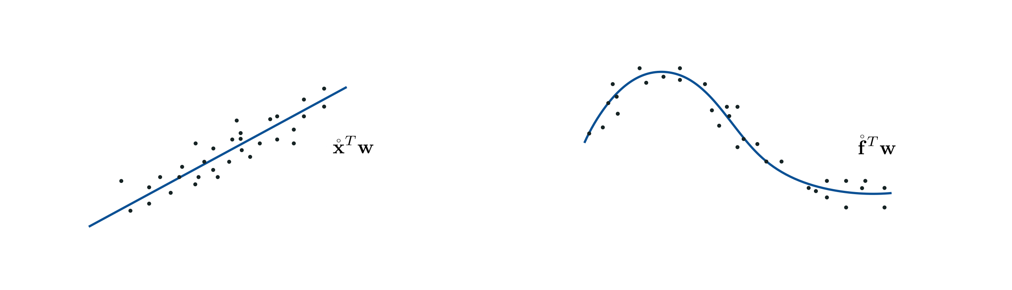
Abstract illustration of linear versus nonlinear regression

Slide 9
Feature engineering

Slide 10
How do we determine the appropriate nonlinear feature transformations for our model, and their number B?
In some simple instances we can determine these by visualizing the data and relying on our own pattern recognition abilities to determine the appropriate nonlinearities.
This kind of practice is referred to as nonlinear feature engineering.

Slide 11
Example: Modeling a familiar wave using a parameterized feature transformation

Slide 12
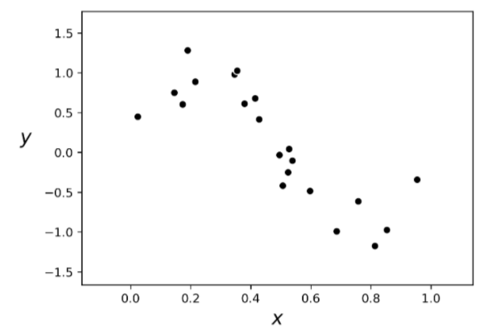

Slide 13

This dataset looks sinusoidal, so we can defensibly propose a `model` consisting of completely *parameterized* sinusoidal function or *feature transformation*
We can then take as our model a linear combination of this nonlinear feature transformation as

Slide 14
Tuning the model parameters by minimizing a Least Squares cost via gradient descent, produces the following fit to our original data.

Slide 15
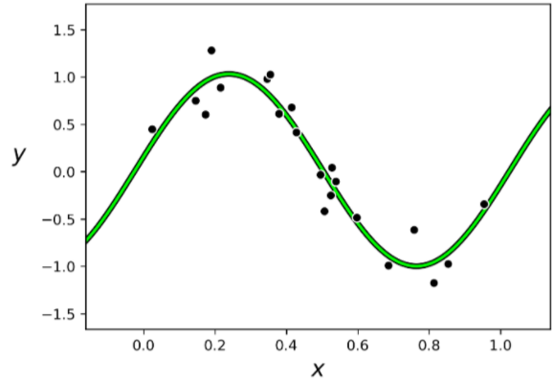

Slide 16
Notice, with our model completely tuned if plot the points our model fits the transformed data *linearly*.
This finding is true in general with nonlinear regression problems.
A properly designed feature (or set of features) provides a good nonlinear fit in the original feature space and, simultaneously, a good linear fit in the transformed feature space.

Slide 17
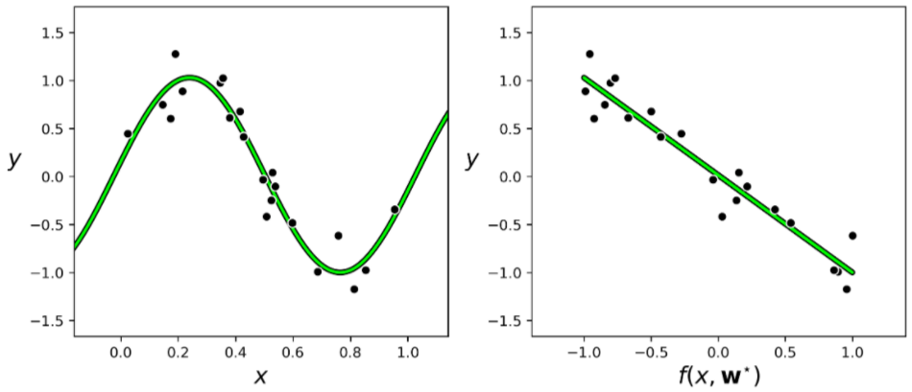

Slide 18
Example: Using an unparameterized feature transformation to model a classic physics dataset

Slide 19




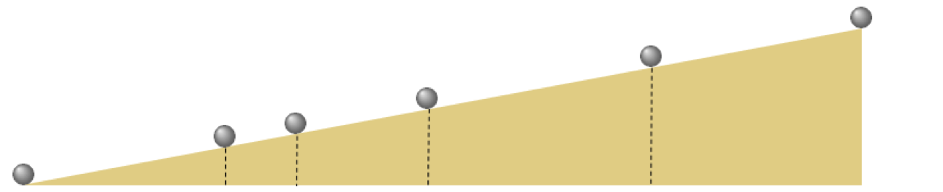
Repeatedly rolling a metal ball down a grooved meter long piece of wood set at an incline, Galileo timed how long the ball took to get , , , , and all the way down the wood ramp.

Slide 20
Data from a modern reenactment of these experiments (averaged over 30 trials), results in the 6 data points shown below.
Here the input axis is the number seconds while the output is the portion of the ramp traveled by the ball during the experiments.

Slide 21
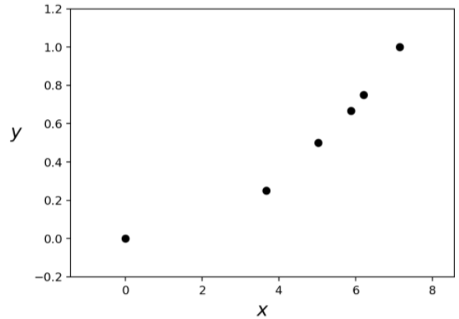

Slide 22



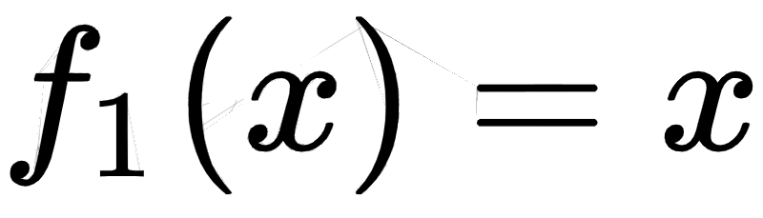
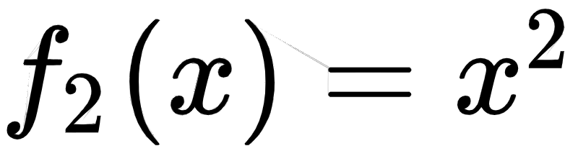
The data here certainly displays a nonlinear relationship and by viewing it - and using his physical intuition Galileo - intuited a *quadratic* relationship.
We can write the proposed model as In our jargon that for some , , and the modeling function
Here we have two unparameterized feature transformations: the identity and the quadratic term .

Slide 23
The following plot shows the best nonlinear fit on the original data as well as corresponding linear fit on the feature transformed data achieved by minimizing a Least Squares cost via gradient descent.

Slide 24
